Slide 1


Slide 2
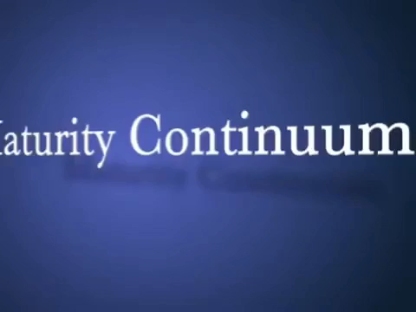

Slide 3
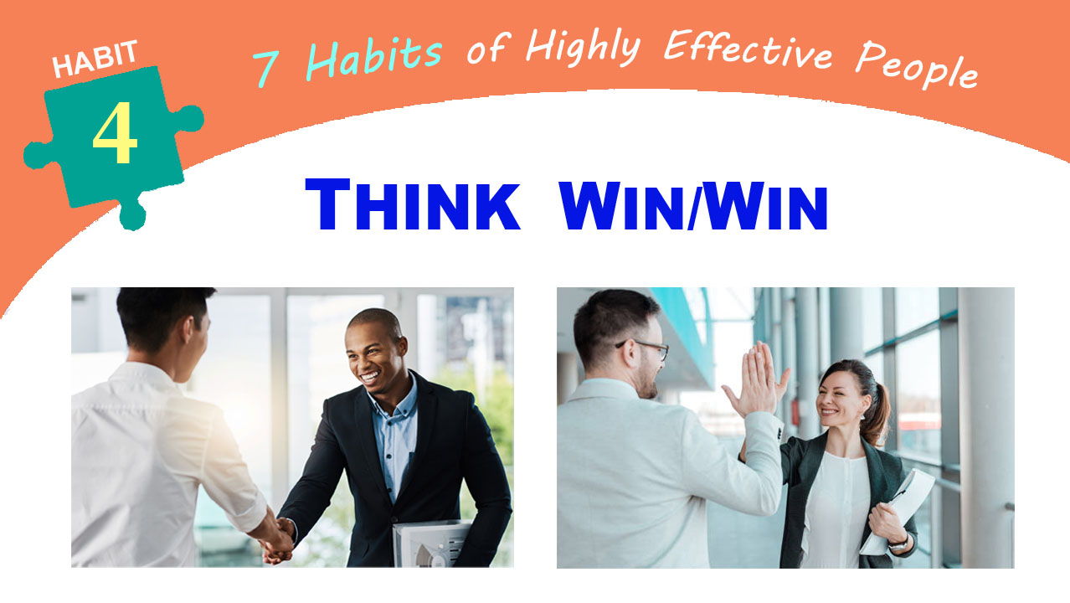

Slide 4
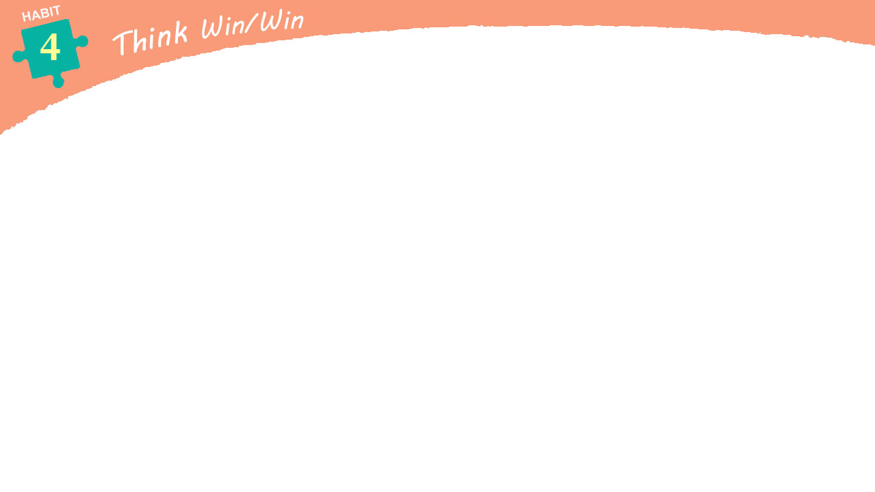

Principles of
Interpersonal Leadership
“We have committed the Golden Rule to memory; let us now commit it to life.”
– Edwin Markham

Slide 5
Stephen Covey was hired by a company whose President was very concerned about the lack of cooperation among his people. The President asked help from Stephen to develop a human relations program that will solve the problem.
He asked the President, “Is your problem the people or the paradigm?”
He replied, “Look for yourself. He found out that there was a real selfishness, unwillingness to cooperate, resistance to authority, defensive communication and overdrawn Emotional Bank Accounts that led to a culture of low trust in the company.

Slide 6

Every time the President meet his people in his office, he will always talk about cooperation, working together and making more money.
He motivates them by showing a chart that were number of horses lined up on a track. Superimposed on the face of each horse was the face of one of his managers. At the end of the track
was a beautiful travel poster of Bermuda, a beautiful picture of blue skies and feathery clouds and a romantic couple walking hand in hand down on a white sandy beach. Then he asks his people, “which of you is going to win the trip to Bermuda?”

Slide 7

In other words, he was setting them up in a COMPETITION with each other. “One manager’s success meant failure for the other managers. “You can’t change the fruit without changing the root.”
So we focused instead in producing personal
and organizational excellence in an entirely
different way by developing information and
reward systems which reinforced the value
of COOPERATION.

Slide 8


Whether you are the president of a
company or the janitor, the moment you step from independence
into interdependence, you step into a leadership role. Leadership means you are in a position of influencing other people.
The habit of effective interpersonal leadership is
THINK WIN/WIN.

Slide 9
6 PARADIGMS OF HUMAN INTERACTIONS
1. Win/Win
2. Win/Lose
3. Lose/Win
4. Lose/Lose
5. Win
6. Win/ Win or No Deal

Slide 10

WIN/WIN
parehong panalo, parehong daog
agreements or solutions that are
mutually beneficial and satisfying.
all parties feel good about the decision and feel committed to the action plan.
sees life as a cooperative, not a competitive arena.
there is plenty for everybody, one person’s success is not achieved at the expense of the success of others.
belief in the third alternative. “It’s not your way or my way; it’s a better way, a higher way.

Slide 11
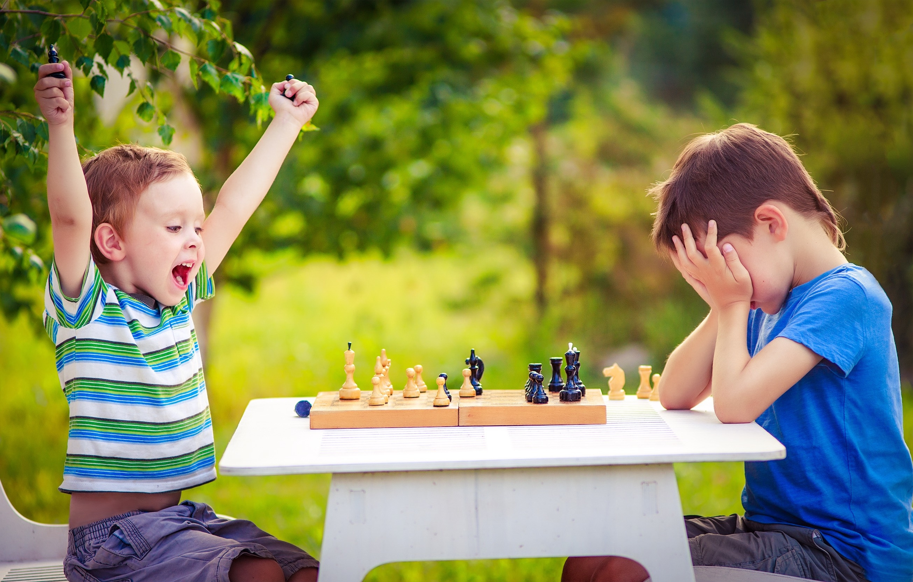
WIN/LOSE
The paradigm of the race to Bermuda. “If I win, you lose.”
“I get my way; you don’t get yours.”
Win/Lose people are prone to use position,
power, credentials, possessions or personality to get their way.
In family, when one child is compared with another.
“If I am better than my brother, my parents will love me more.”
“My parents don’t love me as much as they love my sister. I must not be as valuable.”
Peer pressure
In the academic world- parents try to compare the performance of their child.
In Athletics - life is a big game, “Winning” means “beating”

Slide 12
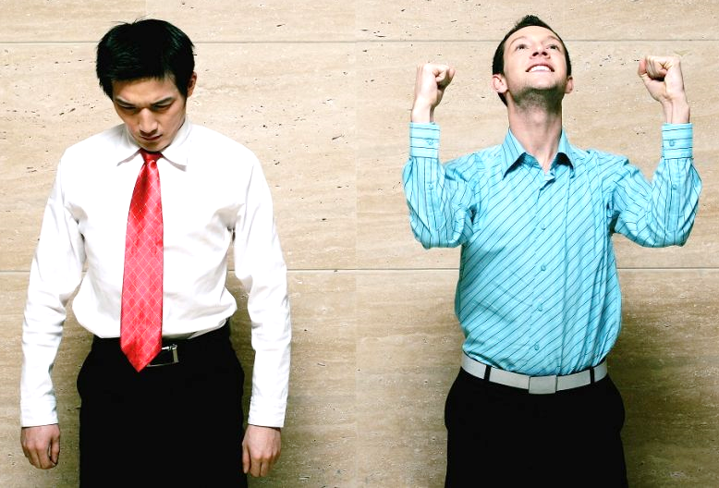
LOSE/WIN
This mentality is worse than WIN/LOSE
because it has no standards -- no demands,
no expectations, no vision. “I lose, you win.”
“Go ahead, Have your way with me.”
“Step on me again, everyone does.”
“I’m a loser. I’ve always been a loser.”
People who think LOSE/WIN are usually quick to please. They have little courage to express their own feelings and convictions and are easily intimidated by the ego strength of others.
WIN/LOSE people love LOSE/WIN people because they can feed on them.
LOSE/WIN people bury a lot of feelings; unexpressed feelings never die, but come forth later in uglier ways.

Slide 13
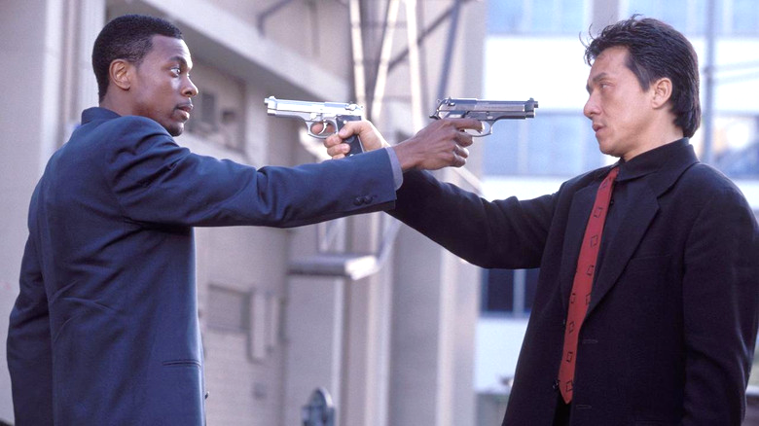
LOSE/LOSE
Some people become so centered
on an enemy they become blind to
everything except their desire for
that person to lose, even if it means losing themselves.
the philosophy of war
philosophy of the highly dependent person without inner direction who is miserable and thinks everyone else should
lose too. “If nobody ever wins, perhaps being a loser isn’t so bad.”

Slide 14

WIN
People with the Win mentality
don’t necessarily want someone
else to lose.
He does not care whether the
other person will win or lose.
What matters is that they win
and they get what they want.

Slide 15
WHICH OPTION IS THE MOST EFFECTIVE?
The answer is, “It depends.” If you win a basketball game, that means the other team loses. (Win/lose)
However, you would not want to set up a Win/Lose situation like the “Race to Bermuda” contest within a company or in a situation where you need cooperation among people.
If you value a relationship and the issue isn’t really that important, you may want to go for Lose/Win in some circumstances. “What I want isn’t as important to me as my relationship with you. Let’s do it your way this time.” The best choice, then, depends on reality and situation.

Slide 16
Most situations, in fact, are part of an interdependent reality, and then Win/Win is really the only workable alternative of the five.
Win/Lose is not workable in many businesses. If I am a supplier to your company, and I win on my terms in our negotiation, I may get what I want now. But will you come to me again? My short-term Win will really be a long-term Lose if I don’t get your repeat business. So it’s is really Lose/Lose in the long run.
Coming up with a Lose/Win, if I am a customer and I bought an item from you, and later on realized that other shops offer the item in a much cheaper price but same quality, I would regret buying from you and will not buy from you again. In the long run, we both lose.
That’s why Win/Win is the only real alternative in interdependent realities.

Slide 17
WIN/WIN OR NO DEAL
No Deal- means that if we can’t find a solution that would benefit us both, we agree to disagree agreeably – No Deal. No expectations have been created.
With No Deal as an option, you can honestly say, “I only want to go for Win/Win. I want to win, and I want you to win. I wouldn’t want to get my way and have you not feel good about it, because in the end there will be negativities... So let’s work for a Win/Win. And if we can’t find it, then let’s agree that we won’t make a deal at all. It would be better not to deal than to live with a decision that will hurt both of us. Then maybe another time we can try again.”
Provides a tremendous emotional freedom in the family relationship and in other relationships.

Slide 18
WIN/WIN people have these
3 qualities –
1. MATURITY
2. ABUNDANCE MENTALITY
3. SYSTEM

Slide 19
1. MATURITY – is the balance between courage and consideration.
“Emotional Maturity” – the ability to express one’s own feelings and convictions balanced with consideration for the thoughts and feelings of others.
To go for WIN/WIN, you not only have to be nice, you have to be courageous; not only empathic but confident; not only considerate and sensitive, but brave to achieve that balance between courage and consideration. It is the essence of real MATURITY.

Slide 20
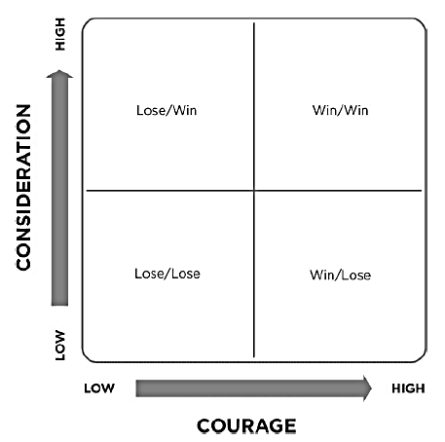




If I’m high on courage and low on consideration, how will I think? Win/Lose. I’ll be strong and ego bound. I’ll have the courage of my convictions, but I won’t be very considerate of yours.
If I’m high on consideration and low on courage, I’ll think Lose/Win. I’ll be so considerate of your convictions and desires that I won’t have the courage to express and actualize my own.
High courage and consideration are both essential to Win/Win. It is the balance that is the mark of real maturity. If I have it, I can listen, I can empathically understand, but I can also courageously confront.

Slide 21

2. ABUNDANCE MENTALITY –
the paradigm that there is
plenty out there for everybody.
Scarcity Mentality –People with this kind of mentality have a very difficult time sharing recognition and credit, power or profit even with those who help in the production. They are always comparing, always competing.

Slide 22
3. SYSTEM
For WIN/WIN to work, the systems have to support it. For example in a company there should be training system, planning system, communication system, budgeting system, and the compensation system.
If there is no WIN/WIN system, you’ll be in the situation of the manager mentioned earlier who talked cooperation but practiced competition by creating a “Race to Bermuda” contest.

Slide 23
ACTIVITY: Group into 3.
15 minutes sharing –
Points for sharing:
1. Recall past situations in your life where you engaged in a win/lose, lose/win, lose/lose, or win situation.
Think if Win/Win solutions could have been possible.
2. Share your realizations about Thinking Win/Win and how you can apply it in your current family and work situations.

